Slide 1
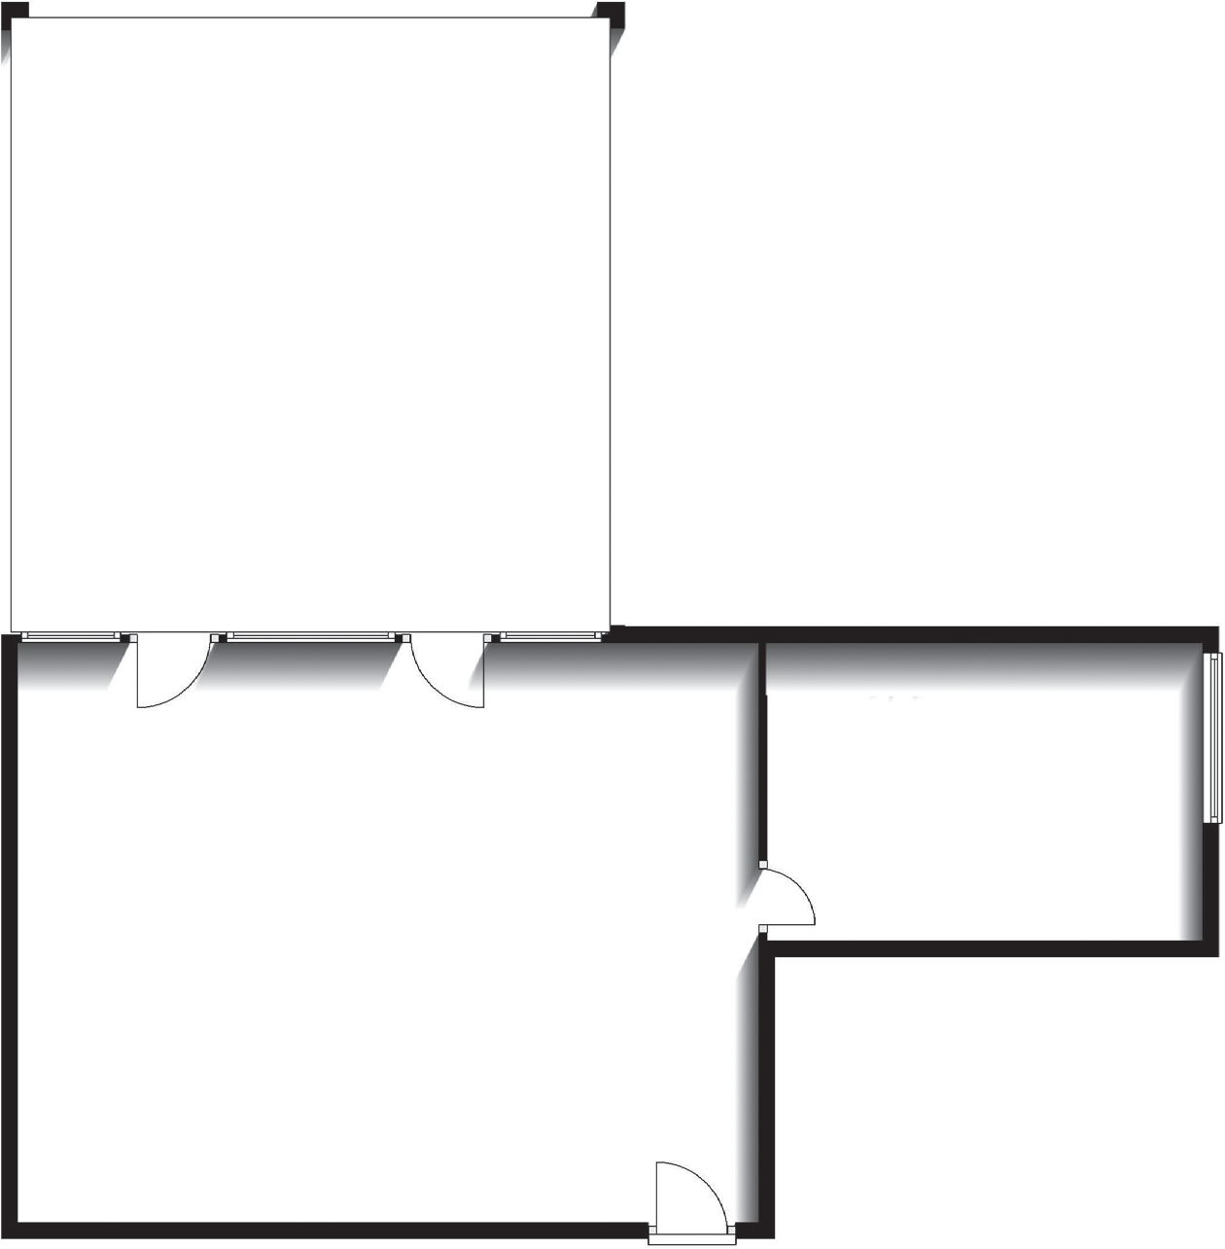
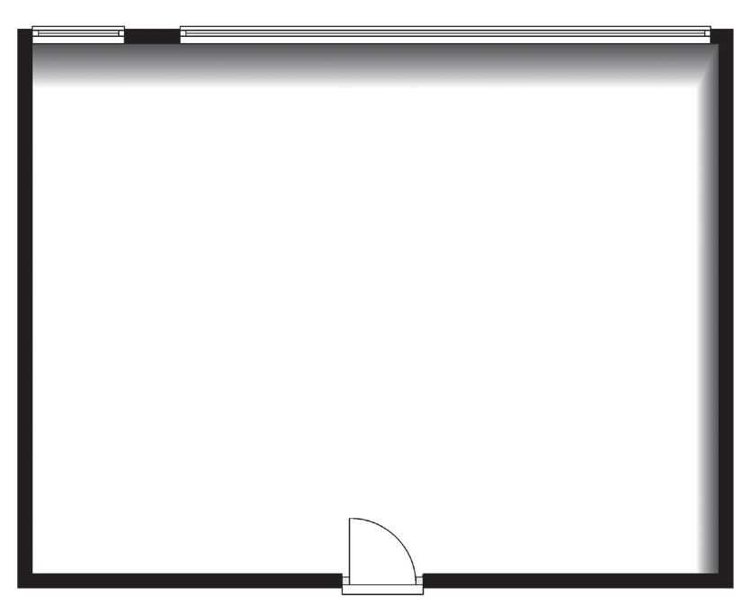
Meeting Rooms 8-12a
FREE
Balcony
7.33m x 7.65m (24’1’’ x 25’1”)
300 MBPS SUPERFAST
WIFI
Indicates a fixed screen
Meeting Room 12a
5.41m x 3.7m (17’9’’ x 12’2”)
Ceiling Height: 2.84m (9’3’’)
Meeting Room
9
4.0m x 7.18m (13’1’’ x 23’7”)
Ceiling Height: 2.84m (9’3’’)
Meeting Room 10
3.47m x 7.18m (11’5’’ x 7’18”)
Ceiling Height: 2.84m (9’3’’)
Meeting Room 8
6.0m x 9.41m (19’8’’ x 30’10”)
Ceiling Height: 2.84m (9’3’’)
Meeting Room 11
9.30m x 7.18m (30’6’’ x 23’7”)
Ceiling Height: 2.84m (9’3’’)
Meeting Room 12
9.2m x 7.18m (30’2’’ x 23’7”)
Ceiling Height: 2.84m (9’3’’)

